Slide 1



Implementing Experimental Ionization Rates in Spectral Models
Grant Mondeel, Amy Gall, Nancy Brickhouse, Randall Smith, Adam Foster
Center for Astrophysics | Harvard & Smithsonian

Slide 2
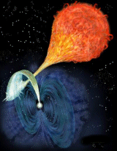
https://www.rkm.com.au/
Paraphrased from Girish 2007: Fe He-⍺/Ly-⍺ ratio of 0.82±0.18 suggests an ionization temperature of 12.4±1.1 keV (~1.4×10⁸±1.3×10⁷ K) using calculations of Mewe 1985.
Question: What temperature uncertainty do we get from experiments?
Notes:
AM Herculis binary system contains a white dwarf and a red dwarf. The white dwarf accreting from red dwarf without an accretion disk. It is the prototypical Polar star (cataclysmic variables with highly magnetized WD).
Collisionally ionized plasma in shock region

Slide 3
Overview
Interpreting spectra from collisionally ionized plasmas requires accurate atomic data (rates, intensity ratios)
This work examines existing experimental electron impact ionization (EII) data for Fe and O to:
Compare against the latest compilation (Urdampilleta 2017)
Provide uncertainties for line ratio diagnostics
Notes:
Interpreting spectra from collisionally ionized plasmas such as supernova remnants (SNR) requires accurate atomic data, like ionization and recombination rates and line intensity ratios.
Data compilations like Urdampilleta are readily available and are integrated in software packages like AtomDB but these rely primarily on theory. Currently, experimental data and their uncertainties are largely unused.
This will help contextualize key plasma characteristics, including H/He ratios line intensity ratios, Fe L shell charge state dist

Slide 4
https://www.rkm.com.au/
Paraphrased from Girish 2007: Fe He-⍺/Ly-⍺ ratio of 0.82±0.18 suggests an ionization temperature of 12.4±1.1 keV using calculations of Mewe 1985.
Question: What temperature uncertainty do we get from experiments?
Notes:
AM Herculis binary system contains a white dwarf and a red dwarf. The white dwarf accreting from red dwarf without an accretion disk. It is the prototypical Polar star (cataclysmic variables with highly magnetized WD).
Collisionally ionized plasma

Slide 5
Methods
Collect experimental cross section data
Convert cross sections to ionization rates and uncertainties
Use Monte Carlo methods and fitting to generate continuous cross section curves
Calculate charge state distribution. Use Monte Carlo methods for uncertainties
Multiply charge state distribution by line emissivities for line ratios
Notes:
Survey/collect EII cross section data for O, Fe
Obtain continuous cross sections [by fitting experimental data, including contributions from direct ionization and excitation-autoionization]
Convert cross sections to rates [convolution]
Apply emissivities from AtomDB
Examine line intensity ratios, etc

Slide 6
Fe cross section data
O cross section data
Fe Charge State (q+) |  | Experiment | Method
Neutral | I | Freund 1990 | Crossed beams
1 | II | Stenke 1999 | Crossed beams
2 | III | Stenke 1999 | Crossed beams
3 | IV | Stenke 1999 | Crossed beams
4 | V | Stenke 1999 | Crossed beams
5 | VI | Stenke 1999 | Crossed beams
6 | VII | Stenke 1999 | Crossed beams
7 | VIII | Hahn 2015 | Ion storage ring
8 | IX | Hahn 2016 | Ion storage ring
9 | X | Hahn 2012 | Ion storage ring
10 | XI | Hahn 2012 | Ion storage ring
11 | XII | Hahn 2011 | Ion storage ring
12 | XIII | Hahn 2011 | Ion storage ring
Fe Charge State (q+) |  | Experiment | Method
13 | XIV | Hahn 2013 | Ion storage ring
14 | XV | Bernhardt 2014 | Ion storage ring
15 | XVI | Gregory 1987 | Crossed beams
16 | XVII | Hahn 2013 | Ion storage ring
17 | XVIII | Hahn 2013 | Ion storage ring
18 | XIX | No experiments | Zhang & Sampson (1990)
19 | XX | No experiments | Zhang & Sampson (1990)
20 | XXI | No experiments | Zhang & Sampson (1990)
21 | XXII | No experiments | Zhang & Sampson (1990)
22 | XXIII | No experiments | Younger (1982)
23 | XXIV | Wong 1993 | Electron beam ion trap
24 | XXV | Yang 2025 | Electron beam ion trap
25 | XXVI | O'Rourke 2001 | Electron beam ion trap
O Charge State (q+) | Numeral | Experiment | Method
Neutral | I | Thompson 1995 | Crossed beams
1 | II | Lecointre 2013 | Crossed beams
2 | III | Phaneuf 1987 | Crossed beams
3 | IV | Donets 1981 | Electron beam ion source
4 | V | Fogle 2008 | Crossed beams
5 | VI | Crandall 1986 | Crossed beams
6 | VII | Donets 1981 | Electron beam ion source
7 | VIII | Aichele 1998 | Crossed beams
Missing data is replaced by Urdampilleta 2017 with error bars estimated from neighboring experiments
Notes:
First step of analysis

Slide 7
Methods
Collect experimental cross section data
Convert cross sections to ionization rates and uncertainties
Use Monte Carlo methods and fitting to generate continuous cross section curves
Calculate charge state distribution. Use Monte Carlo methods for uncertainties
Multiply charge state distribution by line emissivities for line ratios
Notes:
Survey/collect EII cross section data for O, Fe
Obtain continuous cross sections [by fitting experimental data, including contributions from direct ionization and excitation-autoionization]
Convert cross sections to rates [convolution]
Apply emissivities from AtomDB
Examine line intensity ratios, etc

Slide 8
Production of O⁶⁺ (He-like) from O⁵⁺
Notes:
O5+

Slide 9
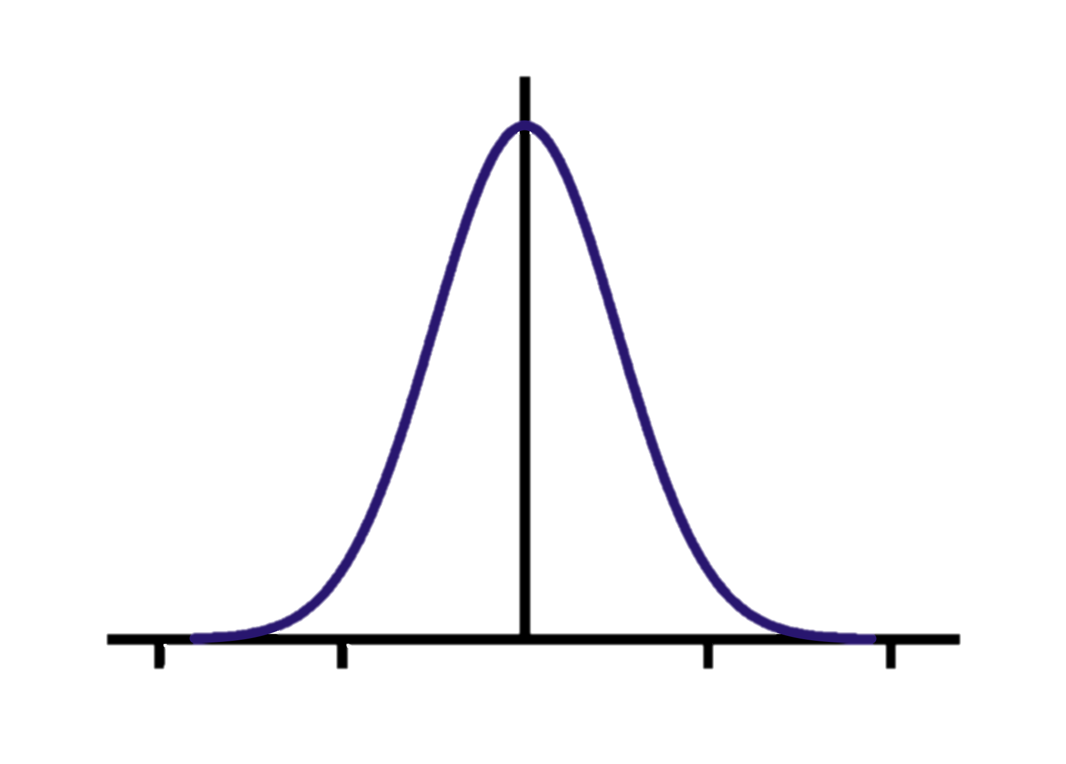
Notes:
O5+

Slide 10
Notes:
O5+

Slide 11
Contribution from excitation-autoionization
Direct ionization cross section (Q_{DI}) contributions fit with
Excitation-autoionization cross section (Q_{EA}) contributions fit with
A, B, C, D, E are fitted parameters
Number of DI and EA curves depends on the ion and data
C and D may be fixed (see Urdampilleta 2017)
Notes:
O5+

Slide 12
N=5 repetitions
Notes:
O5+

Slide 13
N=200 repetitions
Using mean and ±1σ values for next steps
Notes:
O5+

Slide 14
Methods
Collect experimental cross section data
Convert cross sections to ionization rates and uncertainties
Use Monte Carlo methods and fitting to generate continuous cross section curves
Calculate charge state distribution. Use Monte Carlo methods for uncertainties
Multiply charge state distribution by line emissivities for line ratios
Notes:
Survey/collect EII cross section data for O, Fe
Obtain continuous cross sections [by fitting experimental data, including contributions from direct ionization and excitation-autoionization]
Convert cross sections to rates [convolution]
Apply emissivities from AtomDB
Examine line intensity ratios, etc

Slide 15
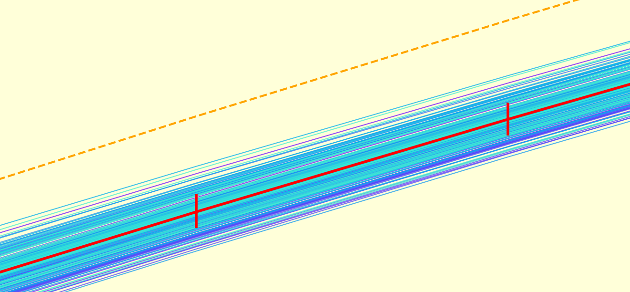
Convolve cross section curves with a thermal electron distribution to get ionization rates:
The mean and ±1σ values are used to calculate the ion balance.
Notes:
Convolve with thermal electron distribution to get rates
Highlight sections where charge states are relevant
Y axis labels

Slide 16
Methods
Collect experimental cross section data
Convert cross sections to ionization rates and uncertainties
Use Monte Carlo methods and fitting to generate continuous cross section curves
Calculate charge state distribution. Use Monte Carlo methods for uncertainties
Multiply charge state distribution by line emissivities for line ratios
Notes:
Survey/collect EII cross section data for O, Fe
Obtain continuous cross sections [by fitting experimental data, including contributions from direct ionization and excitation-autoionization]
Convert cross sections to rates [convolution]
Apply emissivities from AtomDB
Examine line intensity ratios, etc

Slide 17
Charge state distribution (oxygen)
He-Like
H-Like
O 7+ (H-like) | Aichele 1998 | Crossed beams
O 6+ (He-like) | Donets 1981 | Electron beam ion source
O 5+ (Li-like) | Crandall 1986 | Crossed beams
Notes:
Explain legend: dashed=Urdampilleta

Slide 18
Charge state distribution (oxygen)
He-Like
H-Like
O 7+ (H-like) | Aichele 1998 | Crossed beams
O 6+ (He-like) | Donets 1981 | Electron beam ion source
O 5+ (Li-like) | Crandall 1986 | Crossed beams
Notes:
Explain legend: dashed=Urdampilleta

Slide 19
Charge state distribution (oxygen)
He-Like
H-Like
O 7+ (H-like) | Aichele 1998 | Crossed beams
O 6+ (He-like) | Donets 1981 | Electron beam ion source
O 5+ (Li-like) | Crandall 1986 | Crossed beams
Notes:
Explain legend: dashed=Urdampilleta

Slide 20
He-like O ionizing to H-like O
No data points at low energies make fitting difficult
Donets 1981
Method: Electron beam ion source

Slide 21
Large metastable signal skews cross section data
Data from Stenke 1999 (Crossed-beam)
Notes:
notice discrepancy at 200 eV
We need to convert data points into a continuous cross section curve, which we will do via monte carlo simulation:
wiggle data points up/down randomly based on their uncertainty
Plots without markers so error bars are visible
Explain EA/DI contributions

Slide 22
Methods
Collect experimental cross section data
Convert cross sections to ionization rates and uncertainties
Use Monte Carlo methods and fitting to generate continuous cross section curves
Calculate charge state distribution. Use Monte Carlo methods for uncertainties
Multiply charge state distribution by line emissivities for line ratios
Notes:
Survey/collect EII cross section data for O, Fe
Obtain continuous cross sections [by fitting experimental data, including contributions from direct ionization and excitation-autoionization]
Convert cross sections to rates [convolution]
Apply emissivities from AtomDB
Examine line intensity ratios, etc

Slide 23
Oxygen He-⍺/Ly-⍺ Diagnostic
±2%
±8%
± 94%
Notes:
O a/La

Slide 24
He-Like
L Shell
H-Like
Fe 18+ to 22+: No experimental data (using Urdampilleta)
Fe 25+ (H-like) | O’Rourke 2001 | Electron beam ion trap
Fe 24+ (He-like) | Yang 2025 | Electron beam ion trap
Notes:
L shell, dark blue, matches because most of them are missing experimental data

Slide 25
Iron He-⍺/Ly-⍺ Diagnostic
± 20%
± 30%
± 47%
Notes:
Temp uncertainties are large where data exist

Slide 26
https://www.rkm.com.au/
Paraphrased from Girish 2007: Fe He-⍺/Ly-⍺ ratio of 0.82±0.18 suggests an ionization temperature of 12.4±1.1 keV (~1.4×10⁸±1.3×10⁷ K) using calculations of Mewe 1985.
Question: What temperature uncertainty do we get from experiments?
Notes:
AM Herculis binary system contains a white dwarf and a red dwarf. The white dwarf accreting from red dwarf without an accretion disk. It is the prototypical Polar star (cataclysmic variables with highly magnetized WD).
Collisionally ionized plasma in shock region

Slide 27
Iron He-⍺/Ly-⍺ Diagnostic
± 42%
(± 9% from Girish 2007)
Notes:
Temp uncertainties are large where data exist

Slide 28
Summary
Experimental data is not available for Fe¹⁸⁺ through Fe²²⁺
High quality experimental data is needed for many ions of O and Fe
Many data points, broad range of energies
Metastable ions
Integrating uncertainties remains an unsolved problem

Slide 29
Acknowledgements
We gratefully acknowledge funding from CHANDRA theory grant TM3-24004X.

Slide 30
*Error bars are smaller than the point size
Data from Stenke 1999 (Crossed-beam)
Notes:
notice discrepancy at 200 eV
We need to convert data points into a continuous cross section curve, which we will do via monte carlo simulation:
wiggle data points up/down randomly based on their uncertainty
Plots without markers so error bars are visible
Explain EA/DI contributions

